Slide 1
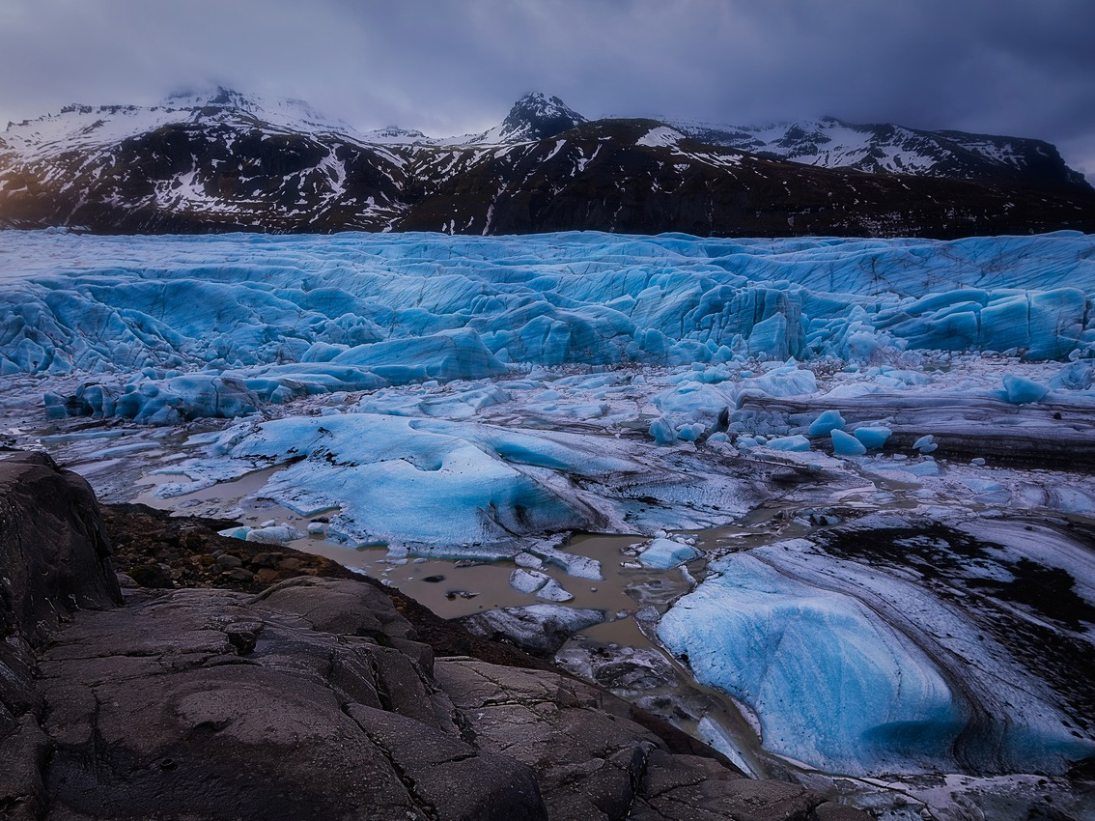
ATAR geography 3.13-3.14
Kimberly Wade-Wear #19956736

Slide 2
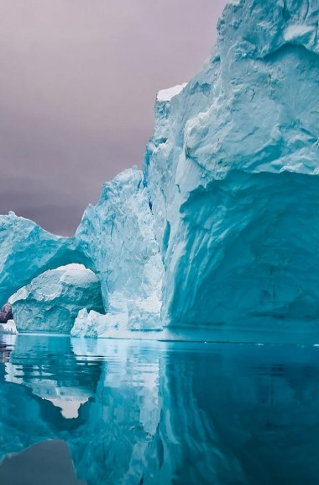
sYLLABUS POINTS
The causes (natural and anthropogenic) and rate of global climate change
One major type of evidence for climate change through geological time
One major type of evidence for climate change in recent human history

Slide 3
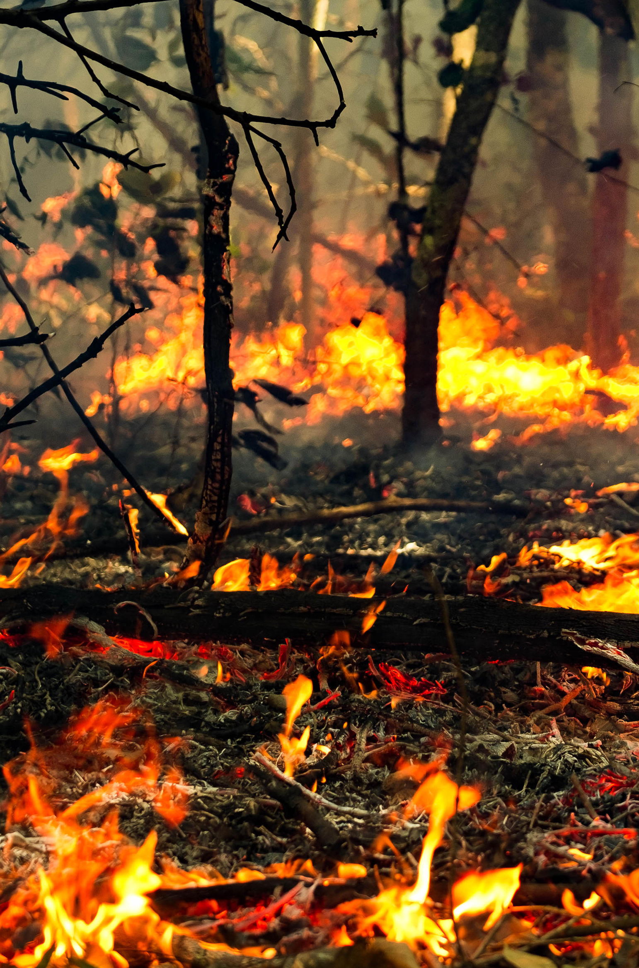
tHE nATURE OF cc
Dictated primarily through:
An overall global temperature rise
Shift in the spatial distribution of precipitation and it’s amount
The increase in the intensity and frequency of extreme weather events (i.e Australian bushfires…… why?)

Slide 4

The nature of CC
Dictated secondarily through:
Sea level rise (predicted to rise 30cm by 2020)
Distribution of vectors and disease (Malaria spreading due to warmer climates).
Alterations to structure and dynamics of ecosystems
Alterations to climate interactions
Impacts of economic activity

Slide 5
Natural causes of Climate change
Volcanic Activity: Ash deflects insolation away from the Earth’s surface, thus producing a cooling effect. Quieter eruptions produce a heating effect.
Albedo: The change in sea ice land cover affects reflectivity between seasons.
Earth’s axis and orbit: More tilt on the axis produces more intense seasons. The degree of roundness influence winter and summer extremes and the expansion and retraction of ice sheets.
Biosphere: Ice is replaced by vegetation, with dead organisms emitting CO2.
Solar output: Sunspots occur on an 11-year cycle, which has a temporary impact on insolation.

Slide 6
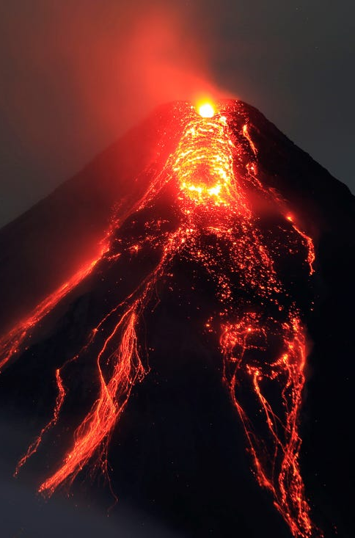
Volcanoes
Explosive eruptions – produce a cooling effect as large amount of fine ash (aerosols) are released and reflect sunlight. (Krakatoa, Santa Maria, El Chichon)
Quite eruptions – Release large amount of CO2 and increase the Greenhouse Gas Effect. Hence leading to a warming climate.

Slide 7
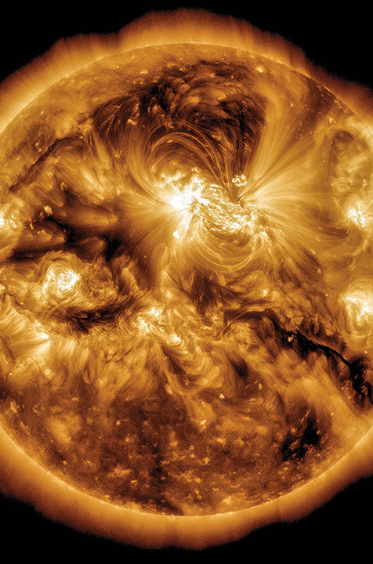
Solar cycles
Tilt – More tilt leads to more severe seasons. This changes between 22-25 degrees every 41,000 years
Distance from the sun:
Aphelion: When the earth is further away from the sun
Perihelion: When the earth is close to the sun
Solar output
Sunspot – Region of increased solar activity on the Suns surface.
Increased number of sunspots can affect the temperature on earth.

Slide 8
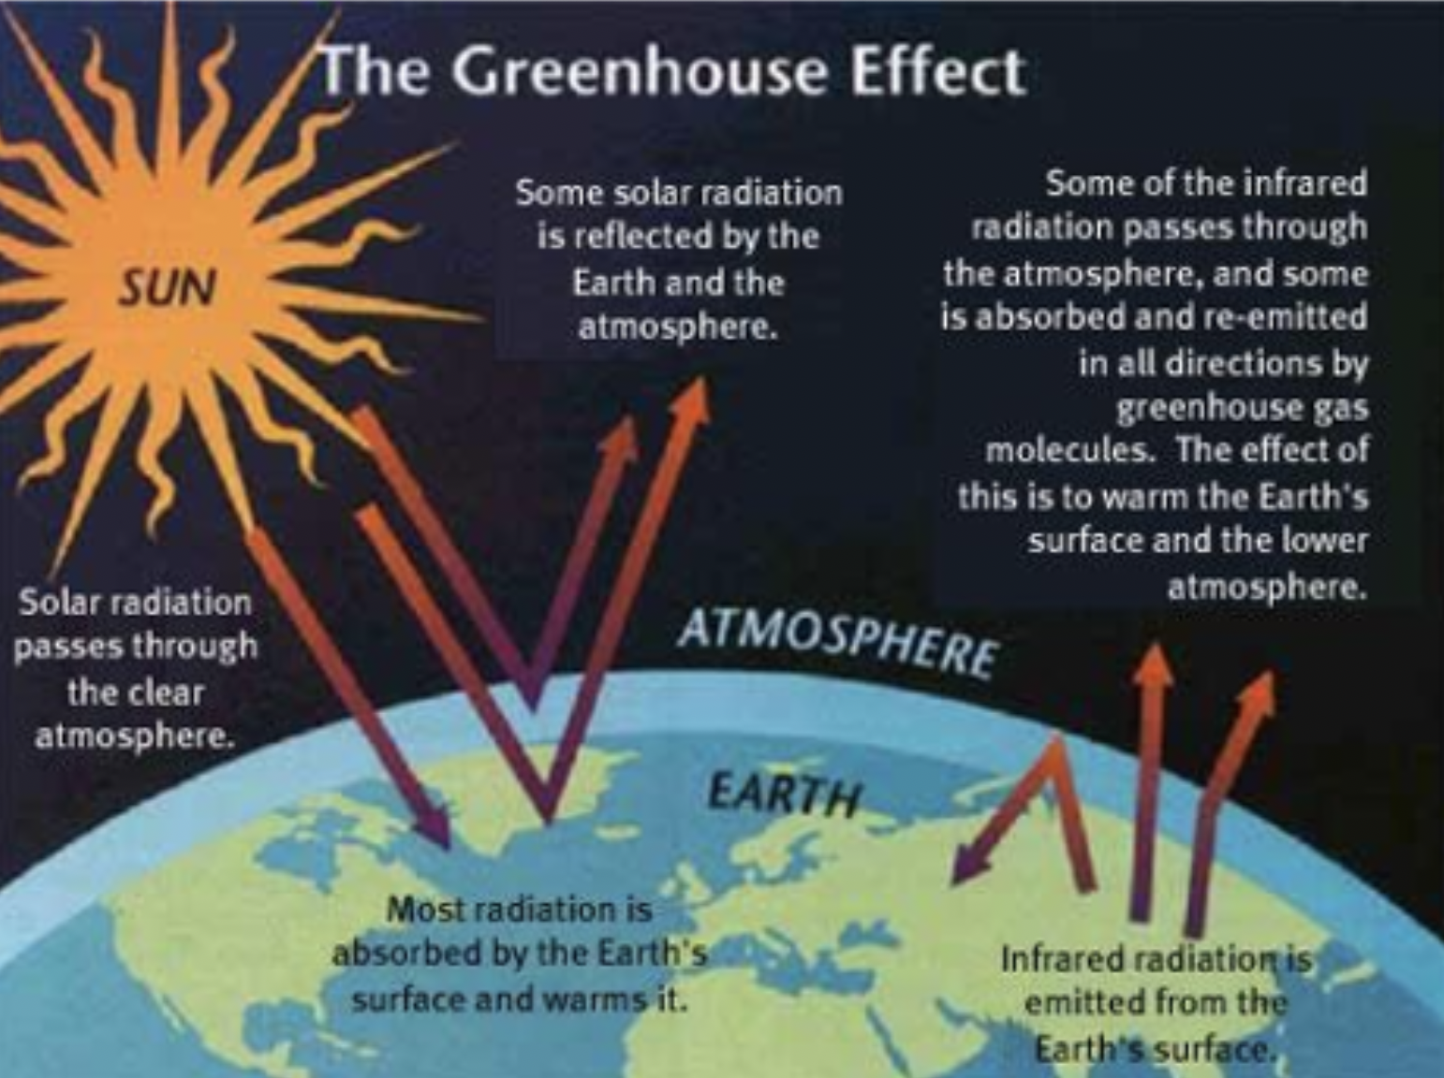
Anthropogenic causes of cc
Fossil Fuels: Burning and extraction of dead organisms causes the release of CO₂ and CH₄, which contributes to the enhanced greenhouse effect.
Infrared radiation is unable to escape due to the thickened atmosphere caused by the GHG’s. This then creates a warming effect contributing to global warming.

Slide 9
Anthropogenic causes of CC
Mining: Mixed impact through open-cut release of CO₂/CH₄ into the atmosphere and pollution of streams and drainage systems. Not as significant however for a mining site to be built, land is cleared and the extraction and processing of coal releases GHG emissions
Cement manufacture: Chemical reaction produces large amounts of CO₂ as well as the energy required to produce it. Calcium Carbonate (CaCO3) needs to be heated to 1450 degrees, this releases excess CO2
Smelting: Production of metals requires large amounts heat, coal and electricity. In order to produce 1000kg of steel, 2000kg of CO2 is released

Slide 10
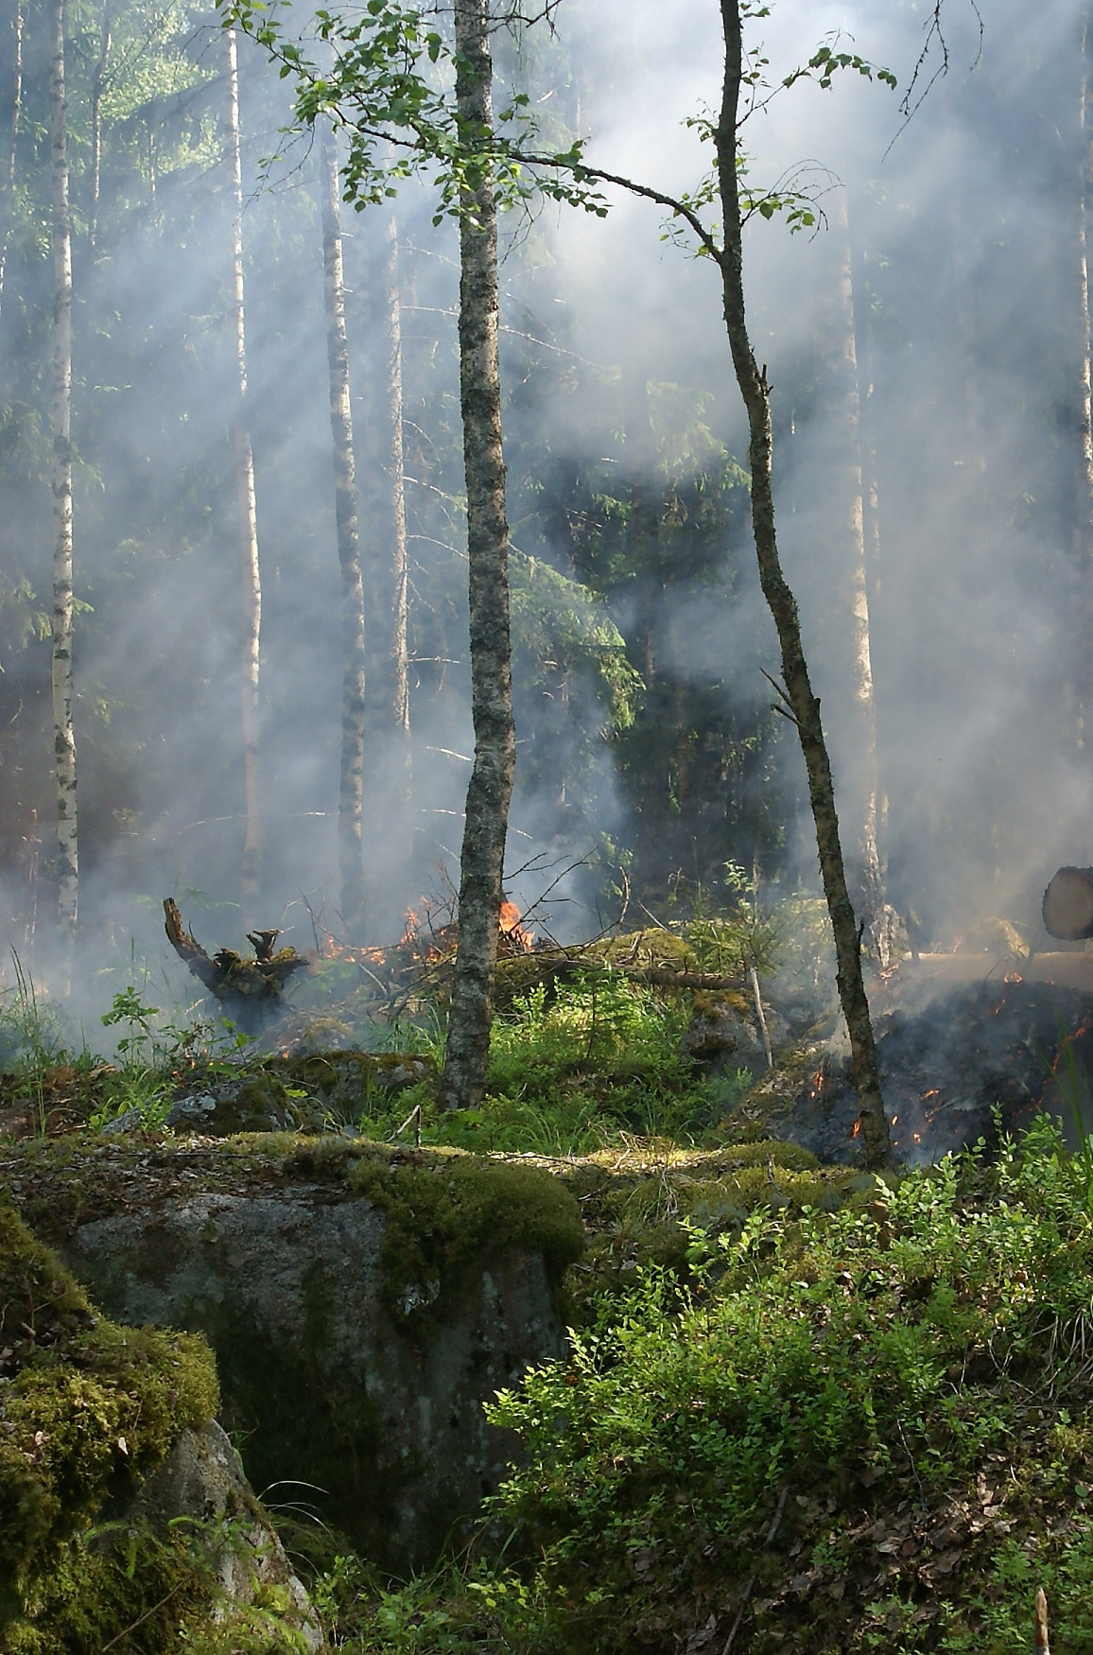
Anthropogenic Causes of CC
Deforestation: Forest soils dry and reduce evaporation. The lack of vegetation leads to extreme temperatures and the reduction in the ability to remove excess CO₂ from the atmosphere.
Leads to a drier climate as transpiration is removed from the hydrological cycle
Loss of trees reduces biosphere capacity to remove CO2
Burning releases CO2 from woody cells in trees

Slide 11
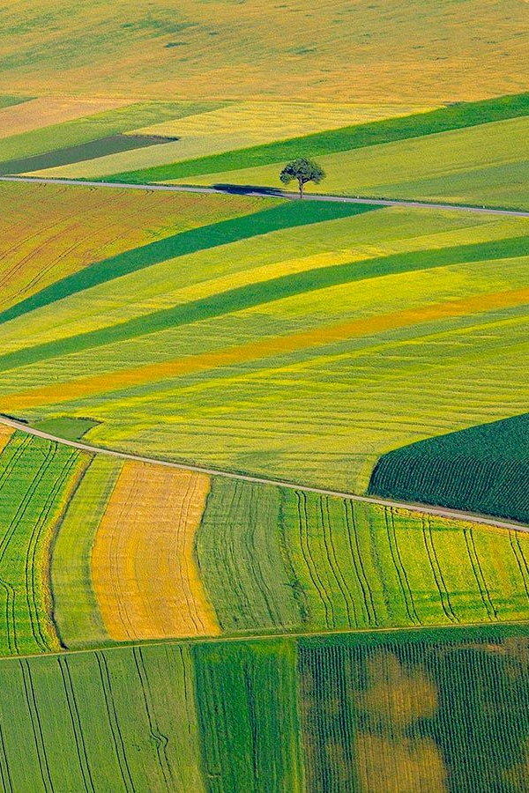
Anthropogenic causes of cc
Agriculture: Clearing of land affects CO₂ exchange.
CO2 and CH4 are released through agricultural processes, mainly from cattle, sheep and rice fields.
10,000 litres of water is required to produce 1kg of beef
A single cow on average produces between 70 and 120 kg of methane per year and, worldwide, there are about 1.5 billion cattle.
Livestock on average emit 200-500 litres of methane daily

Slide 12
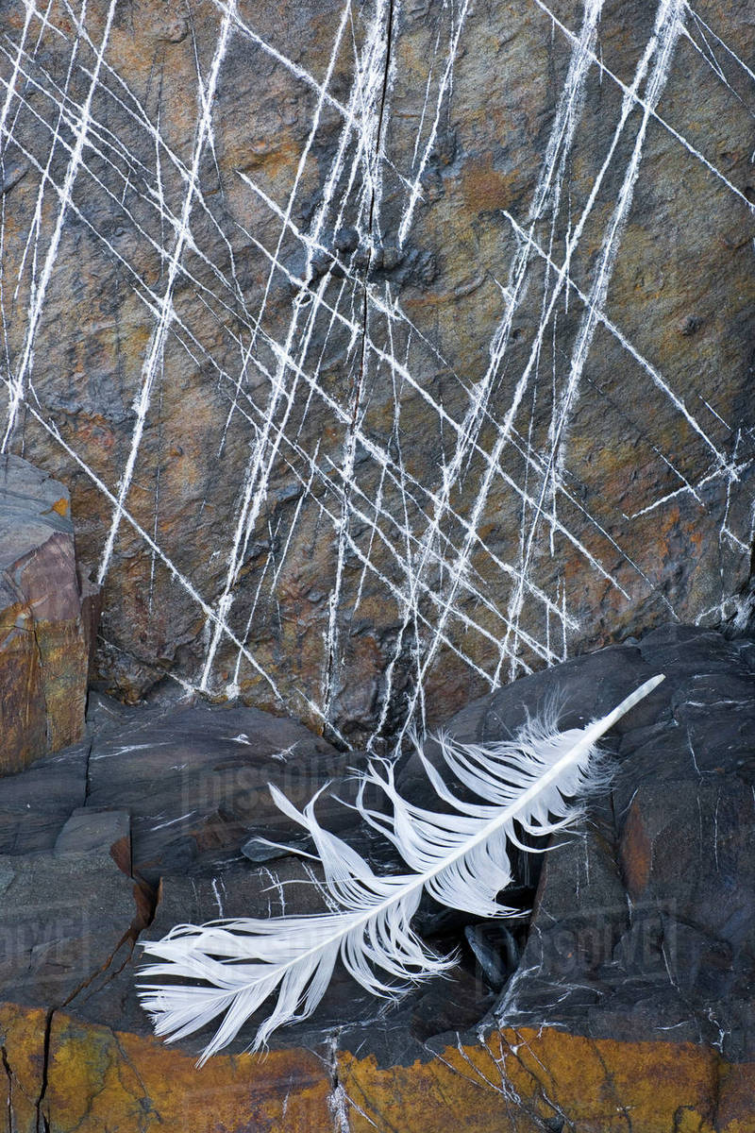
Geological evidence
Rock striations are rock scratchings that are evidence to suggest the existence of climate change in geological time.
These are found on the edges of rocks, along mountain ranges and coastal land shelves.
The retraction of glaciers, ice sheets and frozen ground cause these striations to occur, primarily in the cryosphere.

Slide 13
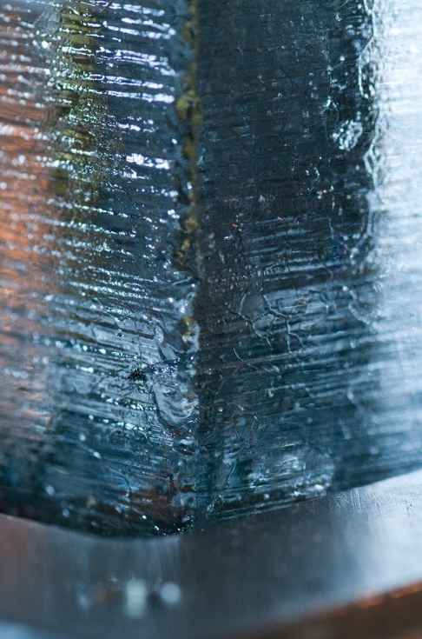
Geological evidence
Also studied through the use of proxy data; ice cores, dendrochronology and coral bleaching.
Ice cores are obtained by drilling into ice sheets (mainly in Greenland and Antarctica).
Can be used to reconstruct a climatic record over the age of the ice core.
As ice forms from the annual build up form layers of snow it contains remnants of dust, ash, pollen and bubbles of atmospheric gases.
An ice core from Vostok, Antartica and provided information of the last 420,000 years and clearly indicated four past glacial cycles.

Slide 14
Geological Evidence
Carbon Dioxide Sampling
Samples of CO2 (ppm: parts per million) trapped in soil/ice:
High CO2 levels indicates warm periods
Low CO2 levels indicates cool periods
Chemical isotopes
Oil Deposits
Oil is formed from the decaying of organic matter, ie plants and animals. Therefore oil deposits indicate to us that the climate of that area was once suitable for life.

Slide 15
Recent Human History Evidence
The continued rise in sea levels is evidence to suggest the existence of climate change in recent human history. As a result of increasing temperatures, sea level rise is attributed to the reduction in the ice sheet biome and permafrost of the tundra biome. Ice sheets like the Antarctic, contribute to sea level rise at a rate of approximately 0.42mm a year.
World weather records began in 1923 and they produce large volumes of monthly data. Some stations have been collecting data since the earlier part of the 1800’s.
From these records we have observed changes to local and regional patterns (e.g decline in annual precipitation in the South West of WA and a significant increase in wet season rainfall over North-West Australia).
Been observed that the globally averaged near-surface air temperature rose 0.8 Celsius between 1850 and 2012. In Australia seven of the ten warmest years on record have occurred since 2002.

